Slide 1
Biochemical Analysis Sensing Exploration and Development Laboratory (BASED-Lab)
Biochemical Analysis Sensing Exploration and Development Laboratory (BASED-Lab)
(
Biochemical Analysis Sensing Exploration and Development Laboratory (BASED-Lab)
L
a
BASED
Biochemical Analysis Sensing Exploration and Development Laboratory (BASED-Lab)
Biochemical Analysis Sensing Exploration and Development Laboratory (BASED-Lab)

Slide 2
Biochemical Analysis Sensing Exploration and Development Laboratory (BASED-Lab)
(
L
a
BASED
Biochemical Analysis Sensing Exploration and Development Laboratory (BASED-Lab)
(
L
a
BASED

Slide 3
Biochemical Analysis Sensing Exploration and Development Laboratory (BASED-Lab)
(
c
a
L
B
BASED
Biochemical Analysis Sensing Exploration and Development Laboratory (BASED-Lab)
(
c
a
L
B
BASED
c
Biochemical Analysis Sensing Exploration and Development Laboratory (BASED-Lab)
(
a
L
B
BASED

Slide 4
Biochemical Analysis Sensing Exploration and Development Laboratory (BASED-Lab)
(
c
a
L
B
BASED
Biochemical Analysis Sensing Exploration and Development Laboratory (BASED-Lab)
Biochemical Analysis Sensing Exploration and Development Laboratory (BASED-Lab)
BASE
a
B
(
c
L

Slide 5

Biochemical Analysis Sensing Exploration and Development Laboratory (BASED-Lab)
(
c
a
L
B
BASED
Biochemical Analysis Sensing Exploration and Development Laboratory (BASED-Lab)
Biochemical Analysis Sensing Exploration and Development Laboratory (BASED-Lab)
BASE
a
B
(
c
L

Slide 6
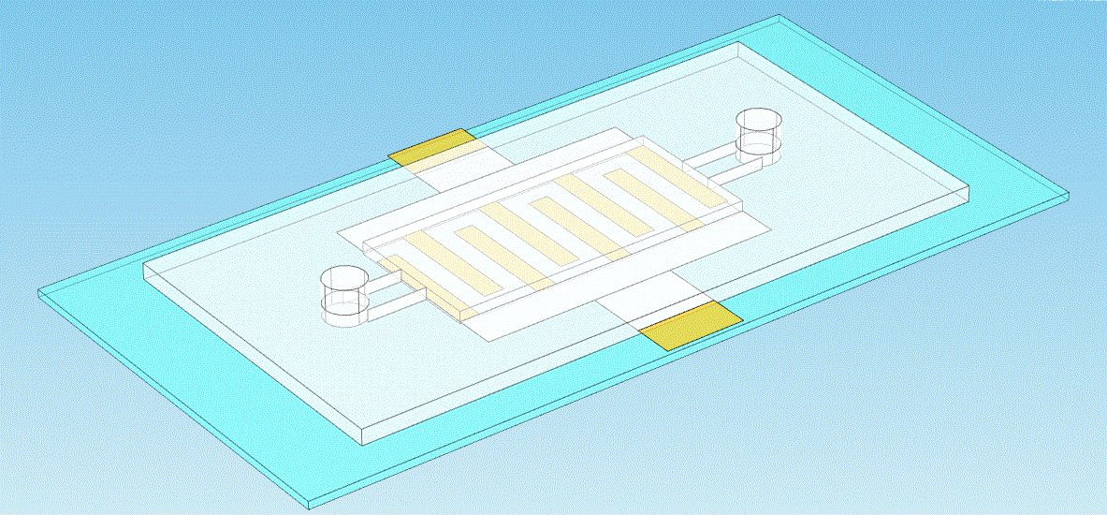
Biochemical Analysis Sensing Exploration and Development Laboratory (BASED-Lab)
Biochemical Analysis Sensing Exploration and Development Laboratory (BASED-Lab)
Inlet port
a
B
(
c
Electrode contact pad
L
Microelectrodes
Outlet port
PDMS cover
Glass substrate

Slide 7
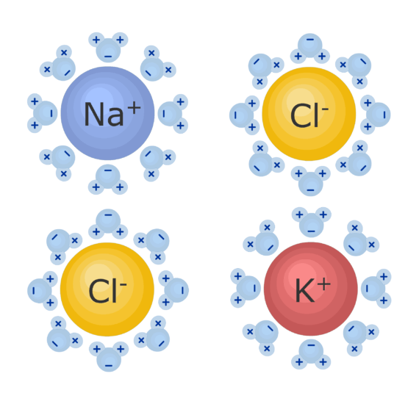

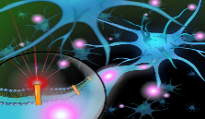
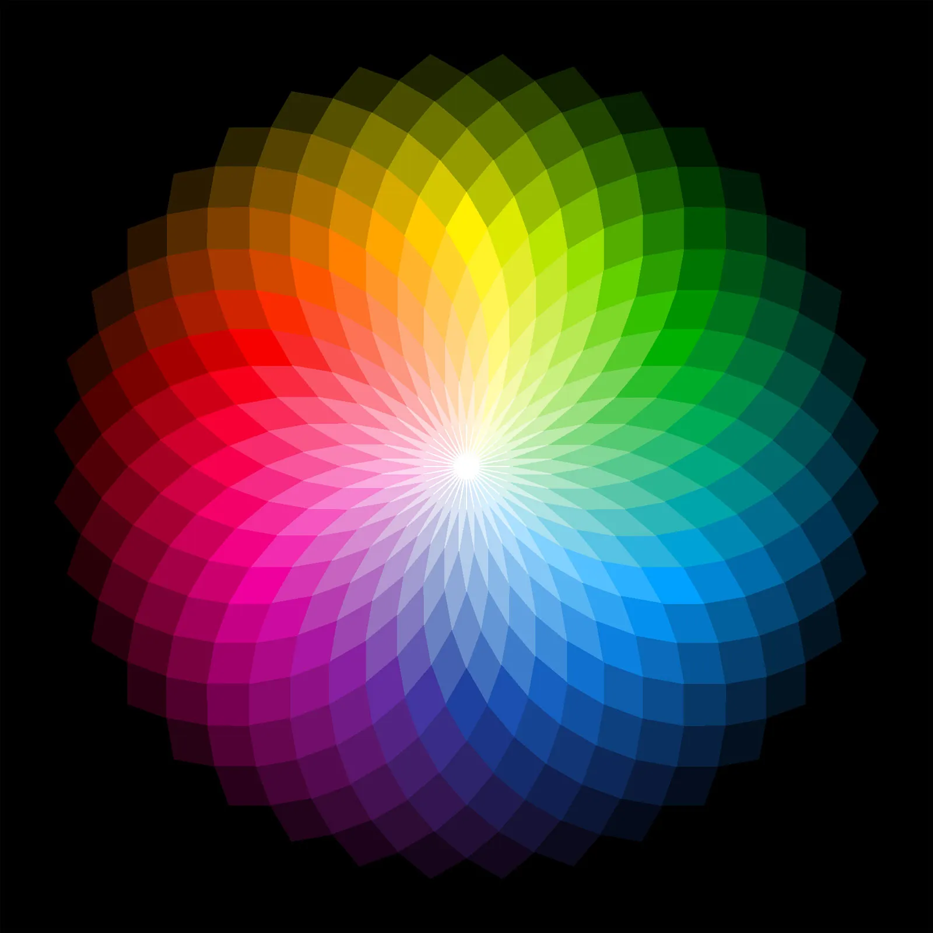
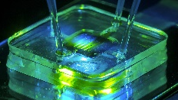
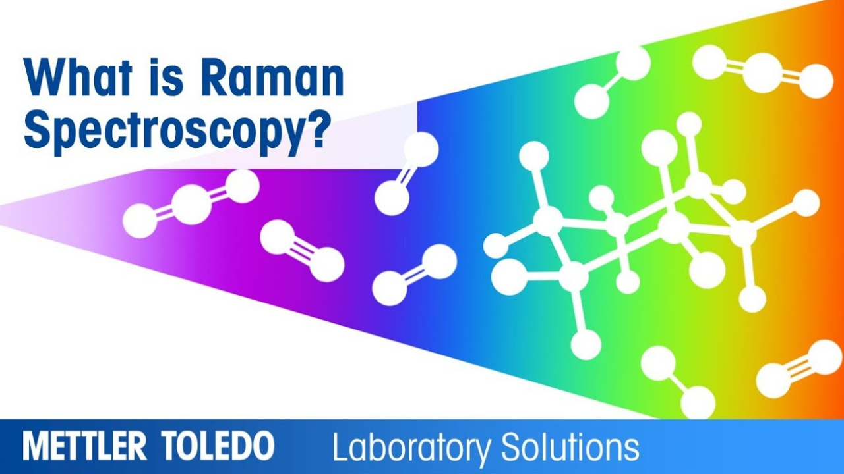

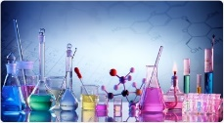

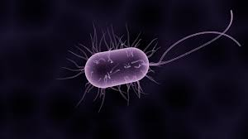
Chemical sensors
Target
Technology
Platform
Ions
Fluorescence
Nanosensors
Colorimetric
Environmental
pollutant
Microfluidic
chip
BASE
Raman/SERS
Biomarkers
Paper sensors
Electrochemistry
Bacteria

Slide 8
Contact Information Office: PS-55 Room 310 Phone: (561) 297-3338 Email: wangr@fau.edu
Our research group focuses on the development of bio/chemical sensors to obtain accurate qualitative and quantitative information on target analytes, thereby facilitating research in environmental, biological (physiological), and pharmaceutical domains. Our work encompasses a multidisciplinary approach, integrating innovative techniques in optics, electrochemistry, and microfluidics. Presently, our research is primarily directed towards three key areas:
Real-time ions and biomarkers sensing at the cellular and in vivo.
Portable device for the environmental pollutant, bacteria, and metal ion selective detection.
Integrated microfluidic platform-based cell/bacteria analysis and drug screening.

Slide 9

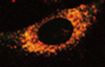

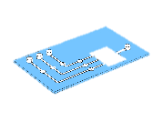
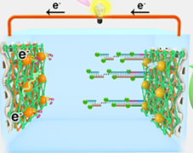
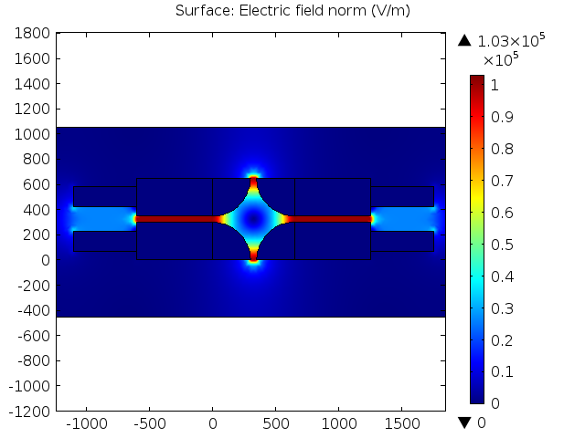

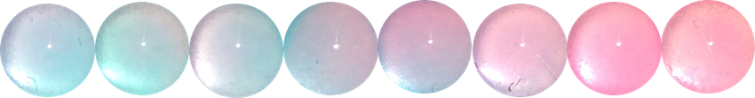
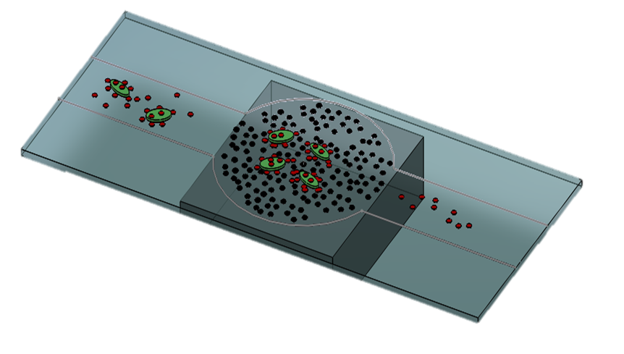
ChemSensX Lab
ChemSensX Lab
Chemical Sensing: Analysis, Exploring, and Development
Nanosensors
Paper sensors
Enzymatic biofuel cell sensing
Research
News
Publications
Personal
Opening
Platform
Technology
Target
Microfluidic
chip
Fluorescence
Colorimetric
Raman/SERS
Electrochemistry
Ions
Environmental
pollutant
Biomarkers
Bacteria
Na⁺
K⁺
Ca²⁺
H⁺
Cl⁻
BASE
The primary objective of the ChemSensX Lab is to tackle detection challenges related to sensitivity, selectivity, portability, and availability in environmental preservation and human health. We strive to accomplish this by developing cutting-edge chemical sensing devices and chemical analysis methods.

Slide 10

ChemSense Lab
ChemSense Lab
Chemical Sensing: Analysis, Exploring, and Development
Research
News
Publications
Personal
Opening
Platform
Technology
Target
Nanosensors
Microfluidic
chip
Paper sensors
More
Optical spectroscopy
Raman/SERS
Electrochemistry
More
Electrolyte
Ions
Environmental
pollutant
Bacteria
More
Na⁺
Ca²⁺
BASE
H⁺
Cl⁻
The primary objective of the ChemSensX Lab is to tackle detection challenges related to sensitivity, selectivity, portability, and availability in environmental preservation and human health. We strive to accomplish this by developing cutting-edge chemical sensing devices and chemical analysis methods.

Slide 11
Nanosensor
Microfluidic
chip
Paper sensor
More
Platform

Slide 12
Optical spectroscopy
Raman/SERS
Electrochemistry
More
Technology

Slide 13
Electrolyte
Ions
Environmental
pollutant
Bacteria
More
Target
Na⁺
Cl⁻
Ca²⁺
BASE
H⁺

Slide 14
ChemSense Lab
Chemical Sensing: Analysis, Exploring, and Development
Research
News
Publications
Personnel
Opening
Platform
Technology
Target
Nanosensor
Microfluidic
chip
Paper sensor
More
Optical spectroscopy
Raman/SERS
Electrochemistry
More
Electrolyte
Ions
Environmental
pollutant
Bacteria
More
Na⁺
Cl⁻
Ca²⁺
BASE
H⁺
The ChemSensX lab aims to tackle detection challenges related to sensitivity, selectivity, portability, and availability in environmental preservation and human health. We strive to accomplish this by developing cutting-edge chemical sensing devices and chemical analysis methods.

Slide 15

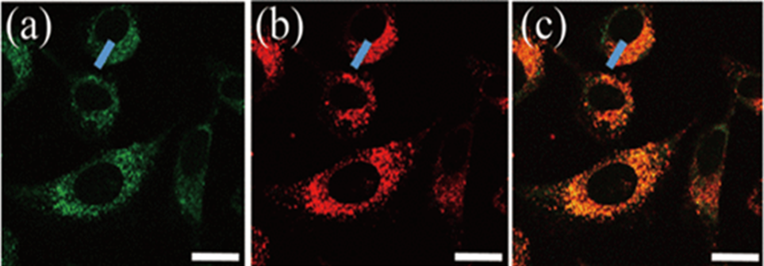
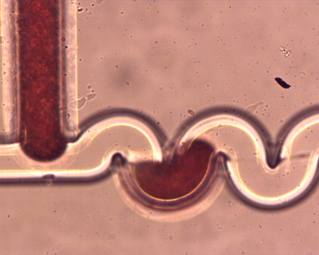
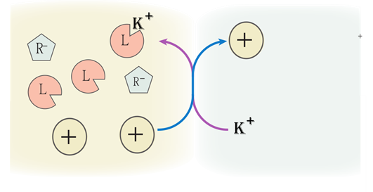
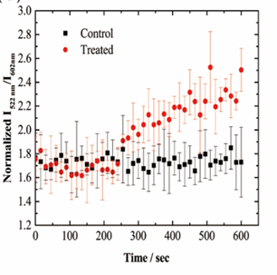

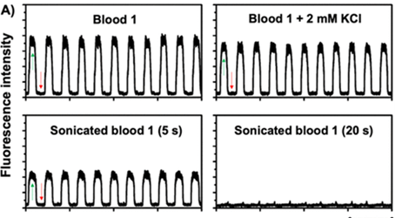

Cellular pH (H⁺) and electrolyte ions (Na⁺, K+, Ca²⁺, etc.) are critical in various cellular processes. However, our understanding of the molecular mechanisms underlying ion physiology and pathology remains incomplete, partly due to the absence of practical tools that accurately measure cellular ion levels, distribution, and transport changes. It is highly desirable to have methods that can measure cellular pH and electrolyte ions with high spatial and temporal resolution while being minimally invasive, highly sensitive, and capable of providing real-time quantitative measurements. Ionophore-based ion-selective sensors exhibit exceptional ion specificity and flexibility that can finely tune the desired dynamic detection range. Ionophore-based ion-selective electrode technique has achieved significant commercial success in blood electrolyte analyzers. We are actively exploring the potential applications of ionophore-based ion-selective sensors in cellular and in vivo settings, as well as their integration into portable devices.
Ionophore based electrolyte ion detection
A
B
Na
Na⁺
A: Ionophore-based nanosensors for intracellular Na⁺ sensing.
B: Blood K⁺ droplet microfluidic analysis

Slide 16
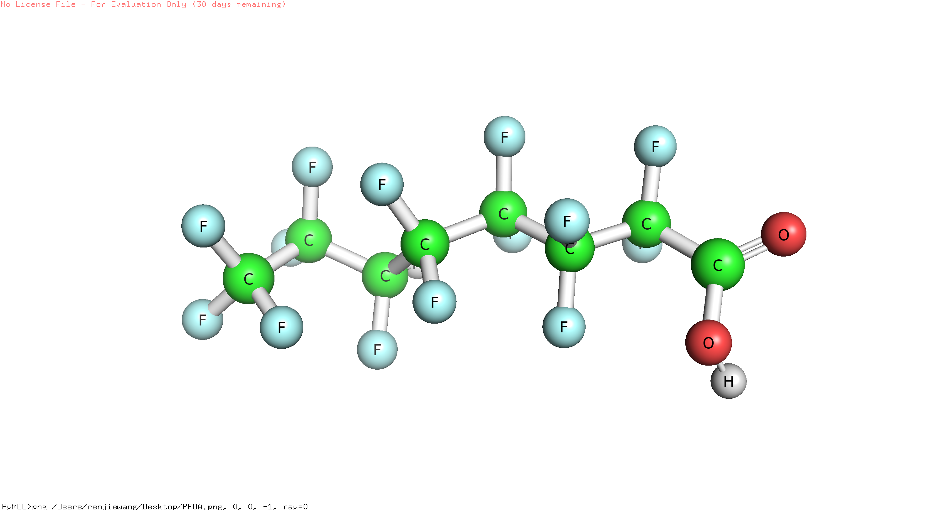
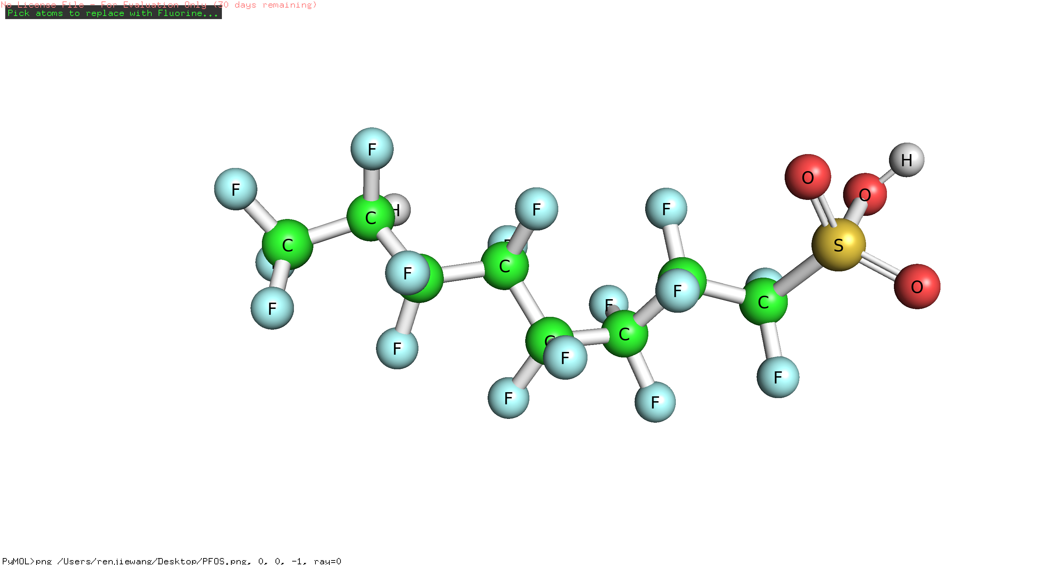
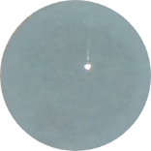
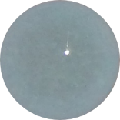
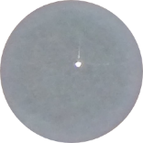
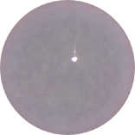
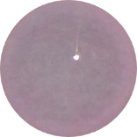
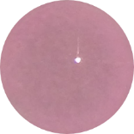
Environmental pollutants significantly impact human health while also causing devastating effects on ecosystems. High costs, time-consuming procedures, and reliance on sophisticated instruments often characterize the methods for environmental pollutant detection, hindering the investigation and mitigation of environmental pollution problems.
There is an increasing need for rapid, sensitive, and low-cost measurement methods that can effectively employ in field and laboratory applications. Our research group is currently engaged in a comprehensive exploration of the challenges involved in environmental pollutant detection. We harness colorimetric sensors and microfluidic analysis to develop innovative methodologies that exhibit significant potential in providing cost-effective, portable, and expeditious detection. A specific emphasis is targeting per- and poly-fluoroalkyl substances (PFAS) and heavy metal ions.
Trace environmental pollutant sensing
Paper based [Pb²⁺] colorimetric sensors
Perfluorooctanoic acid (PFOA)
0.1
1
2.5
5
10
100
[Pb²⁺] / μM
Perfluorooctane sulfonic acid (PFOS)

Slide 17
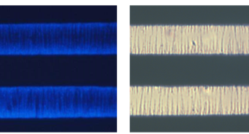
The presence and growth of pathogenic bacteria and biofilm pose significant challenges in various fields, including healthcare, food safety, and industrial settings. Microfluidic chips have exhibited considerable promise in sensitive and real-time bacteria detection. Our group aims to leverage a compact microfluidic platform incorporating chemical and biological functional units to rapidly identify and detect bacteria and biofilm across diverse sample types. Moreover, we are integrating electrochemical detection and dielectrophoresis (DEP) technology, enhancing our approach's accuracy and efficiency.
Pathogenic bacteria rapid detection and biofilm monitoring
Fluorescence labeled bacteria pearl chain
A
B
Microelectrode
Bacteria pearl chain
A: Schematic of microfluidic chip with microelectrode for DEP and electrochemistry test.
B: Bacteria pearl chain formation on the edge of microelectrodes under positive DEP.

Slide 18
Cellular pH (H⁺) and electrolyte ions (Na⁺, K+, Ca²⁺, etc.) are critical in various cellular processes. However, our understanding of the molecular mechanisms underlying ion physiology and pathology remains incomplete, partly due to the absence of practical tools that accurately measure cellular ion levels, distribution, and transport changes. It is highly desirable to have methods that can measure cellular pH and electrolyte ions with high spatial and temporal resolution while being minimally invasive, highly sensitive, and capable of providing real-time quantitative measurements. Ionophore-based ion-selective sensors exhibit exceptional ion specificity and flexibility that can finely tune the desired dynamic detection range. Ionophore-based ion-selective electrode technique has achieved significant commercial success in blood electrolyte analyzers. We are actively exploring the potential applications of ionophore-based ion-selective sensors in cellular and in vivo settings, as well as their integration into portable devices.
Ionophore based electrolyte ion detection
A
B
Na
Na⁺
A: Ionophore-based nanosensors for intracellular Na⁺ sensing.
B: Blood K⁺ droplet microfluidic analysis

Slide 19
Environmental pollutants significantly impact human health while also causing devastating effects on ecosystems. High costs, time-consuming procedures, and reliance on sophisticated instruments often characterize the methods for environmental pollutant detection, hindering the investigation and mitigation of environmental pollution problems.
There is an increasing need for rapid, sensitive, and low-cost measurement methods that can effectively employ in field and laboratory applications. Our research group is currently engaged in a comprehensive exploration of the challenges involved in environmental pollutant detection. We harness colorimetric sensors and microfluidic analysis to develop innovative methodologies that exhibit significant potential in providing cost-effective, portable, and expeditious detection. A specific emphasis is targeting per- and poly-fluoroalkyl substances (PFAS) and heavy metal ions.
Trace environmental pollutant sensing
Perfluorooctanoic acid (PFOA)
Perfluorooctane sulfonic acid (PFOS)
Paper based [Pb²⁺] colorimetric sensors
0.1
1
2.5
5
10
100
[Pb²⁺] / μM

Slide 20
The presence and growth of pathogenic bacteria and biofilm pose significant challenges in various fields, including healthcare, food safety, and industrial settings. Microfluidic chips have exhibited considerable promise in sensitive and real-time bacteria detection. Our group aims to leverage a compact microfluidic platform incorporating chemical and biological functional units to rapidly identify and detect bacteria and biofilm across diverse sample types. Moreover, we are integrating electrochemical detection and dielectrophoresis (DEP) technology, enhancing our approach's accuracy and efficiency.
Pathogenic bacteria rapid detection and biofilm monitoring
Fluorescence labeled bacteria pearl chain
A
B
Microelectrode
Bacteria pearl chain
A: Schematic of microfluidic chip with microelectrode for DEP and electrochemistry test.
B: Bacteria pearl chain formation on the edge of microelectrodes under positive DEP.

Slide 21
Principal Investigator
Renjie Wang, Ph.D. Assistant Professor Email: wangr@fau.edu Office: PS55 Room 310
Ph.D. Students
Mater Students
Undergraduate Students
High school Students

Slide 22
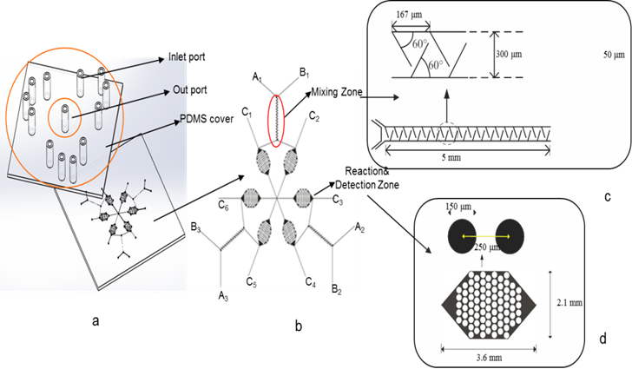
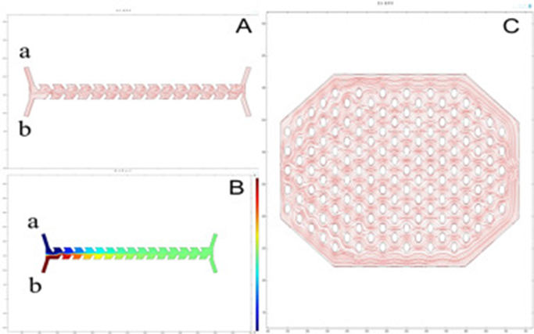
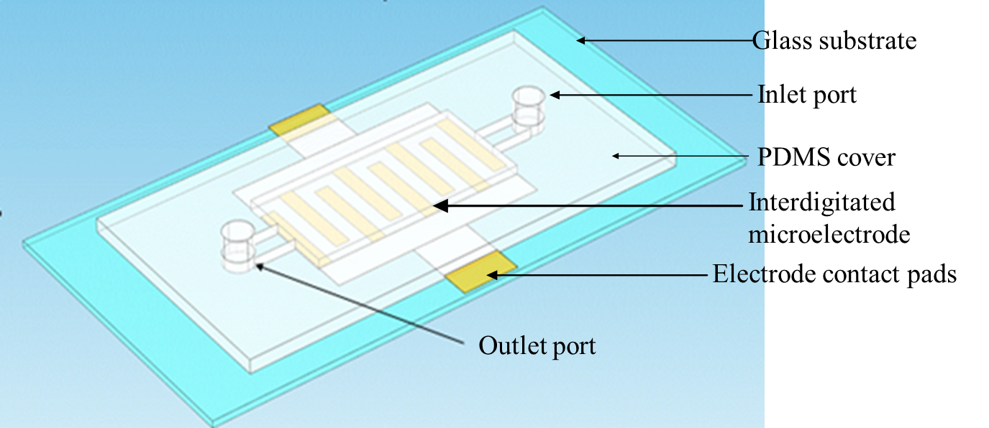

Bacteria detection
Fluorescent nanosensors
Novel microfluidic chip
Immuno-capture and in-situ detection
Schematic of the microfluidic chip
Flow field and concentration distribution simulation
Notes:
we can further simplify the operation procedures and save reagants by using microfluidic chip for bacteria detection.
we designed a novel immune microfluidic chip, which is composed of two parts: a glass substrate with microchannels and a cover formed by polydimethylsiloxane (PDMS), The chip has 6 sample channels, 3 mixing zones and 6 detection zones.
Here shows the simulation of the flow field and concentration distribution, Two liquid samples almost had no mixing at the beginning, but after flowing into the mixing zones, two fluid samples Throughly mixed and in the detection zone, the solution was equally distributed.
which is aoptically clear, inert, and nontoxic.
The chip was composed of 12 sample channels, 3 mixing zones and 6 detection zones. Each mixing zone had a length of 5 mm, depth of 50 μm, and width of 300 μm, and internally, there was a double row of stagger baffles whose intervals were 167 μm. The angulation between the baffle and the microchannel was 60°. This the photo of the microfluidic chip, and this is the mixing zone and here is the detection zone. Stagger baffles set in the mixing zones could enhance the reaction efficiency and provide appropriate velocity and shear stress, which could increase the chances of specific binding and avoid unnecessary nonspecific adsorption. The uplink and downlink staggered cylindrical columns were incorporated into the reaction zones to block liquid sample, as well as provide deceleration zones to increase the probability of interactions between immune reagents. The mixing effect simulation was performed using COMSOL multiphasic software.
Here shows the simulation photographs of the flow field and concentration distribution. Two liquid samples almost had no mixing at the beginning, but after flowing into the mixing zones, two fluid samples obviously mixed with the help of the baffles. After going through the mixing zone, two fluids mixed completely. Throughly mixed and equally distributed.
Here is the flow field simulation diagram of the detection zone. We can see that because of the blocking of the micro cylinders, the solution equally distributed in the designed zone make it feasible for immune capture.

Slide 23
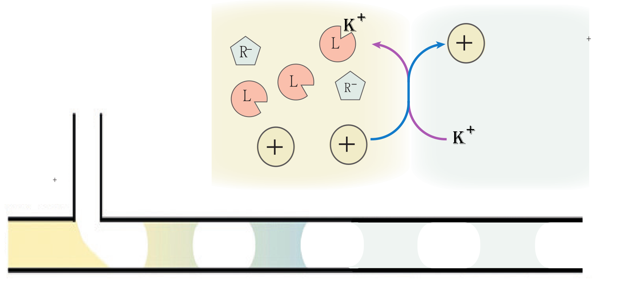
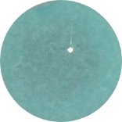
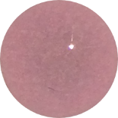
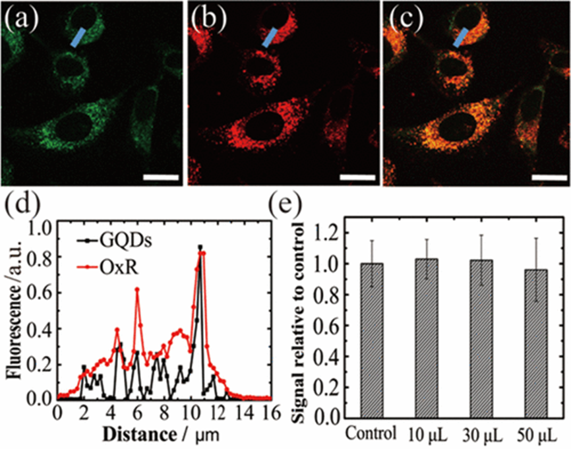

HCl
0.1
1
2.5
5
10
100
NaOH
Ionophore: NaX
Ion exchanger: (TFPB)
Chromoionophore: Ox Red

Slide 24
Ionophore based electrolyte ion detection
Cellular pH (H+) and electrolyte ions (Na+, K+, Ca2+, etc.) are critical in various cellular processes. Imbalances in cellular pH and electrolyte concentrations are associated with numerous diseases. However, our understanding of the molecular mechanisms underlying ion physiology and pathology remains incomplete due to the lack of practical tools for accurately measuring changes in cellular ion levels, distribution, and transport. It is highly desirable to have methods that can measure cellular pH and electrolyte ions with high spatial and temporal resolution while being minimally invasive, highly sensitive, and capable of providing real-time quantitative measurements. Ionophore-based ion-selective sensors exhibit exceptional ion specificity attributed to the strong supramolecular affinity between the ionophore and the target ion. Adjusting the sensing component concentrations can finely tune these sensors to the desired dynamic detection range. Ionophore-based ion-selective electrode technique has achieved significant commercial success in blood electrolyte analyzers. We are actively exploring the potential applications of ionophore-based ion-selective sensors in cellular and in vivo settings, as well as their integration into portable devices.
A
B

Slide 25
07/18/2023: High school researchers Elena Zhu and Daniela Cifuentes Cabrera joined the lab.
07/14/2023: Ph.D. student Md Dulal Hossain Khan joined our group.
07/17/2023: Dr. Wang gave a talk at the Crystal Summer School on Sensors and Chemical Sensors organized by Dr. Vivian Merk.
06/07/2023: Our main lab, SE34-105, is ready for move-in. Ph.D. student Usha Grewal and high school researcher Ken Liu joined the group in the spring semester.
03/15/2023: Dr. Wang (PI) and Dr. Xingquan (Hill) Zhu (Co-PI, Department of Electrical Engineering and Computer Science, FAU) received funding from the Jumpstart Postdoctoral Program for a new multi-disciplinary research initiative.
10/17/2022: Dr. Renjie Wang officially joined the Department of Chemistry and Biochemistry at Florida Atlantic University as assistant professor.

Slide 26
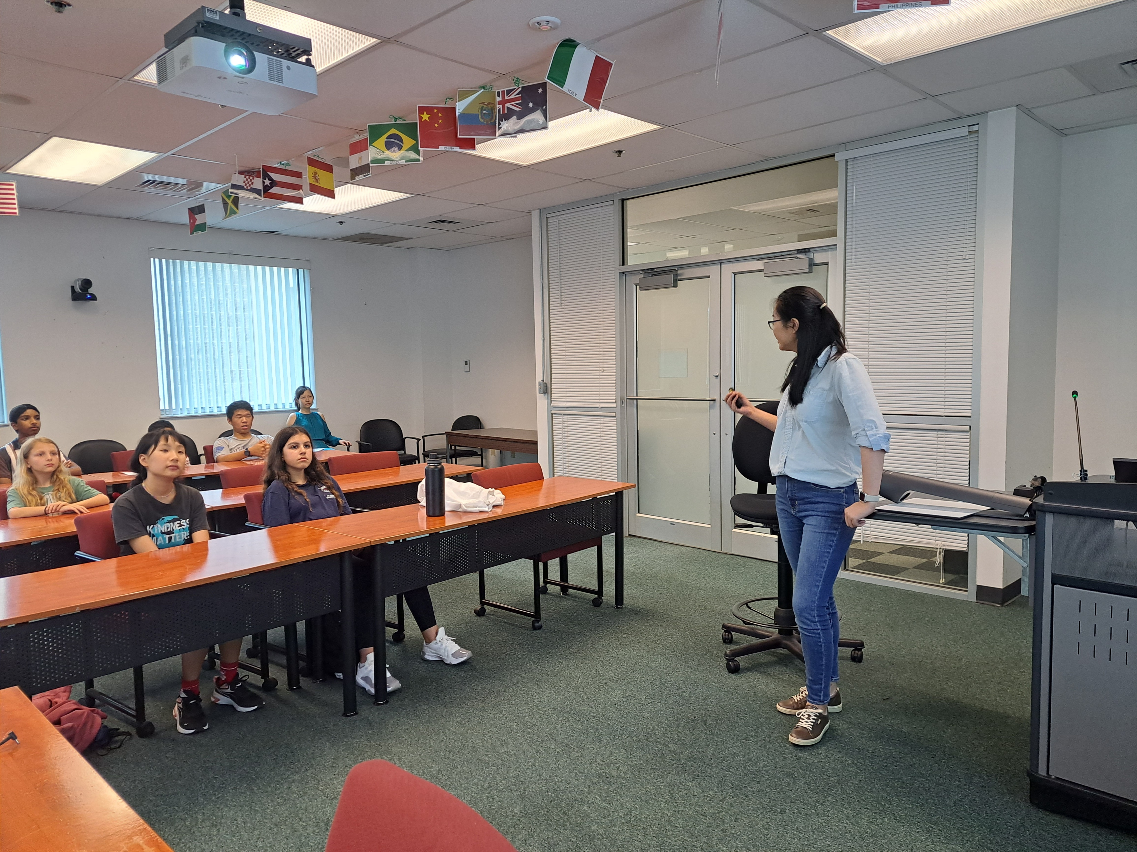
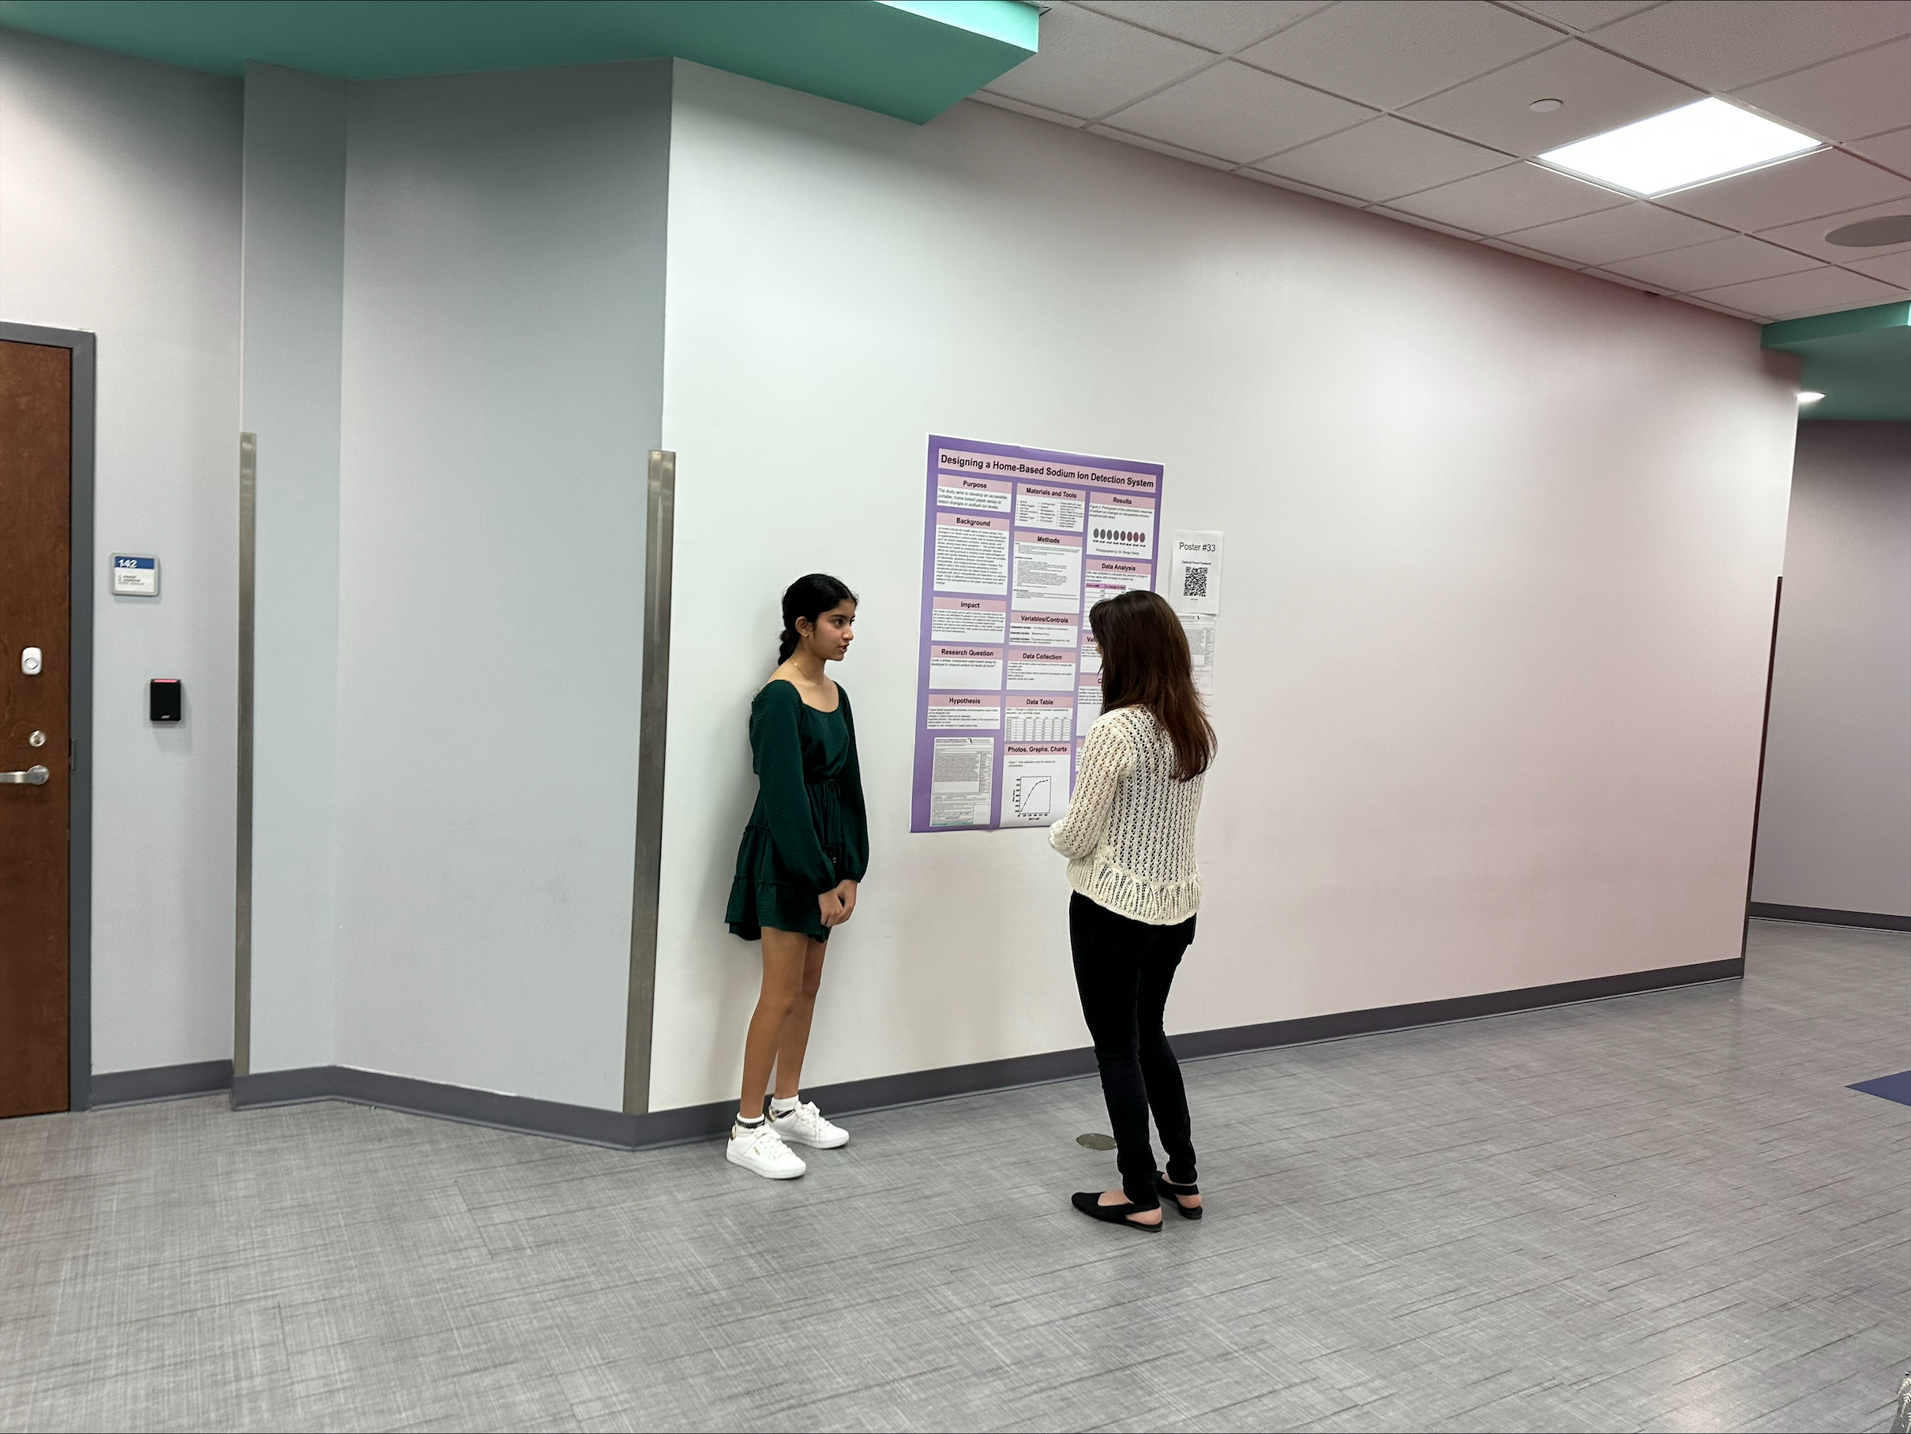

Slide 27




